Slide 1
DATA 824
FINAL PROJECT
Taylor Wilson

Slide 2
What’s The Story?
COVID-19 lockdown was a difficult time for many people. While everyone was stuck inside, many turned to video games to help ease boredom and in some cases loneliness and depression. The data I will be presenting could have implications for video games and mental health – maybe we won’t experience another pandemic, but the information could be useful for determining how and why games can have positive effects on behaviors and mental health in times of distress.

Slide 3
What’s the DATA?
WHERE IS THE DATA FROM?
WHAT IS ANIMAL CROSSING?
The data is from a published paper on behaviors of players in a specific game (Animal Crossing New Horizons) during the COVID 19 pandemic.
Link to paper
Link to original dataset
Animal Crossing New Horizons is a recent entry in a series of video games where the player does things like catch bugs, fish, and decorate their house. It is known for being very cute and relaxing. The game had a massive rise in popularity during the pandemic and is the defining game of that period for many people.
VARIABLES
NOTE!
Region – Where is the player from?
Gender – Male or female
Education Level – What is the max level of education?
Age – Age of the player
Length of COVID-19 Isolation/Social Distancing – Time spent isolating or practicing social distancing
Level of COVID-19 Concern – Four levels: “Not at all,” “A little,” “Worried,” and “Very Worried”
Concern About Environment – Several 5-point Likert questions regarding environmental opinions
Player Behaviors – Several 5-point Likert questions regarding in-game behaviors
Player Feelings – Several 5-point Likert questions regarding player emotional states
The dataset contains more variables than were used as my analysis evolved during the process. They were left in because removing them would wreck my code (something to think about next time)!

Slide 4
ANALYSIS
DESCRIPTIVE DATA
For my descriptive/demographic data, I chose to represent the data with bar charts. This allows for easy counts and clear information.
CORRELATIONS
For my Likert scale questions, I chose correlation tables to show the relationships between the players’ responses to the various questions
A NOTE ON DESIGN PRINCIPLES
I tried my best to adhere to the visualization principles we learned in class. However, I found that my limited knowledge of code prevented me from getting the best possible results. I attempted to make my visualizations easy to read with the least amount of visual clutter possible. I tried to keep my theming and colors consistent throughout the page.

Slide 5
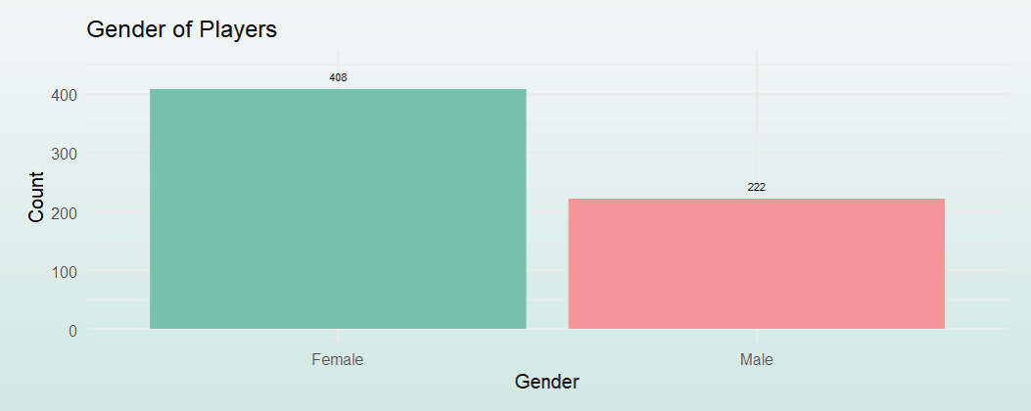
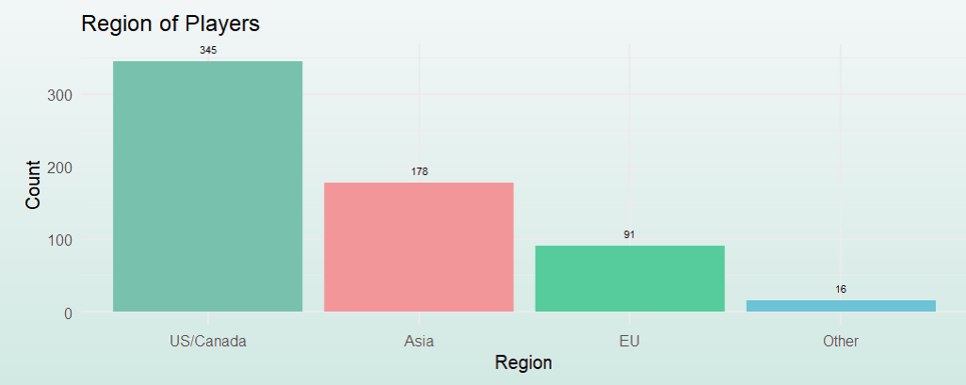
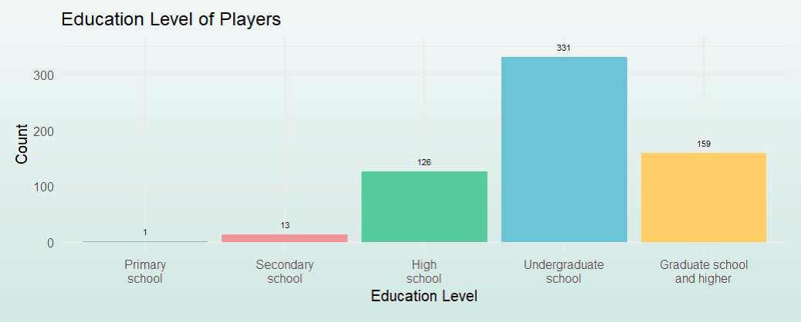
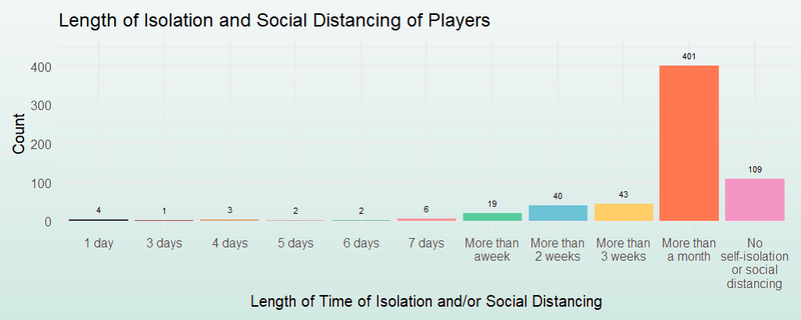
VISUALIZATIONS (PT. 1)

Slide 6
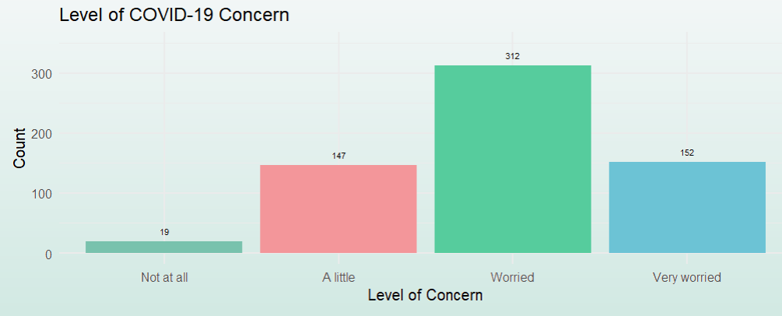
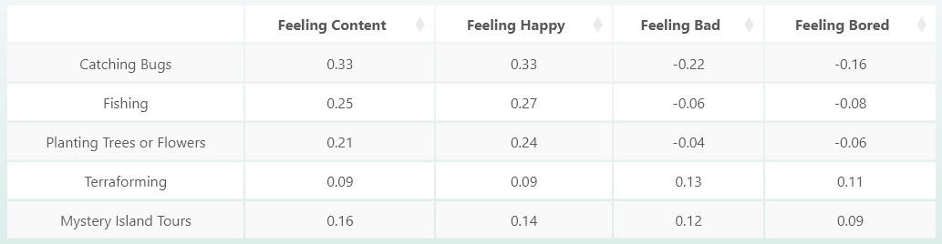
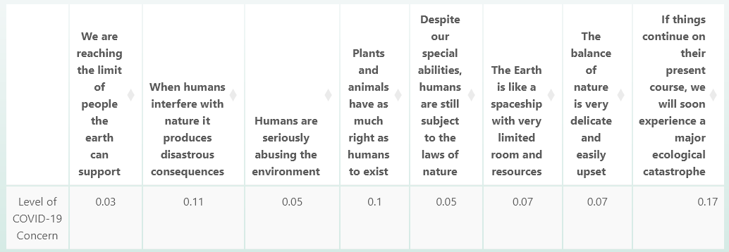
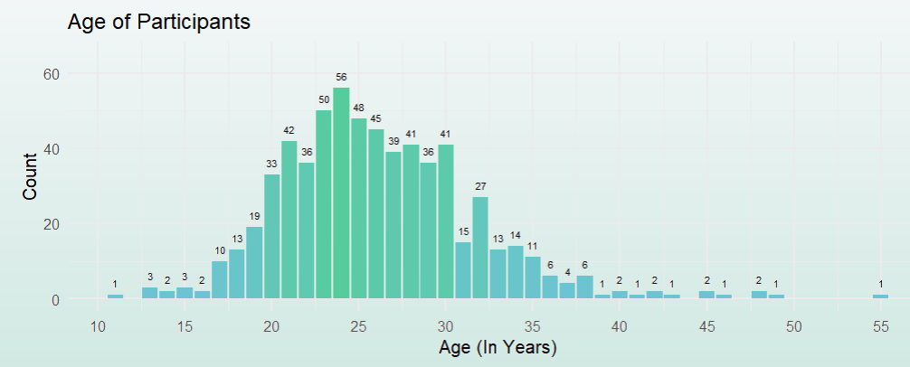
VISUALIZATIONS (Pt. 2)
(note that correlation tables have further explanations on the actual app)

Slide 7
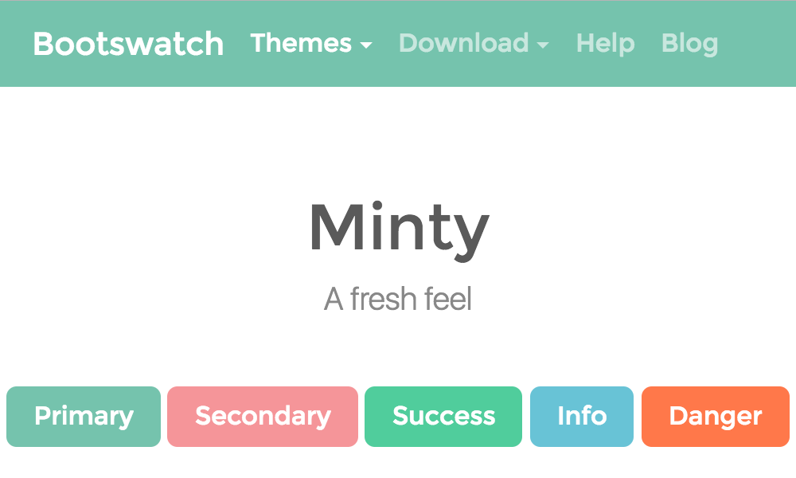
DESIGN PROCESS
THEMING
WHAT/WHERE…
Utilized a Bootswatch theme to create a cohesive look throughout the graphs. Click the image to go to the page for Minty
Tried to keep it as simple as possible with easy to navigate tabs.
…does the application do? It presents various data visualizations in an easy to navigate format.
…do we expect from it? To be able to clearly read the information and interpret the visualizations accordingly.
…does the data come from? The .csv file, but the original data file is linked in slide 3.

Slide 8
INSIGHTS what made this interesting enough to Explore?
1
2
3
In the original survey, players were asked to rate how often they performed certain tasks (for example fishing or catching bugs), with lower value responses representing doing an action less often. Additionally, they were asked to rate their feelings when playing the game, with higher scores indicating a stronger feeling. The data seems to indicate that players feel happier and content when fishing or catching bugs, and more bored and bad when terraforming or going on mystery island tours. However, these correlations are rather weak.
Players were asked to rate their level of COVID-19 concern, with "Not at all" being the lowest value and "Very worried" being the highest value. Additionally, players were asked to answer eight 5-point Likert scale environmental concern questions (where 1 represents strong disagreement and 5 represents strong agreement). This data implies that players with higher levels of COVID-19 concern tend to feel like we as humans are on the path to ecological destruction and that humans have negative impacts on nature. Like the previous correlations, these are also weak.
One table examines the correlations between the previously mentioned "Level of COVID-19 Concern" as well as player tasks. This data was interesting to me because I did not expect there to be any sort of relationship (despite the weakness) between COVID concern and mystery island tours, but it is the highest value on the table. Perhaps a possible explanation for this could be that players with high levels of concern tended to make up for traveling in real life with traveling in the game.
Finally, there were insights from the correlations between the previously mentioned "Level of COVID-19 Concern" as well as player emotional state. At first these results seemed surprising, but after thinking about it, they do make sense. If you have a high level of COVID concern, you are probably still feeling bad or bored, even while playing a game.

Slide 9
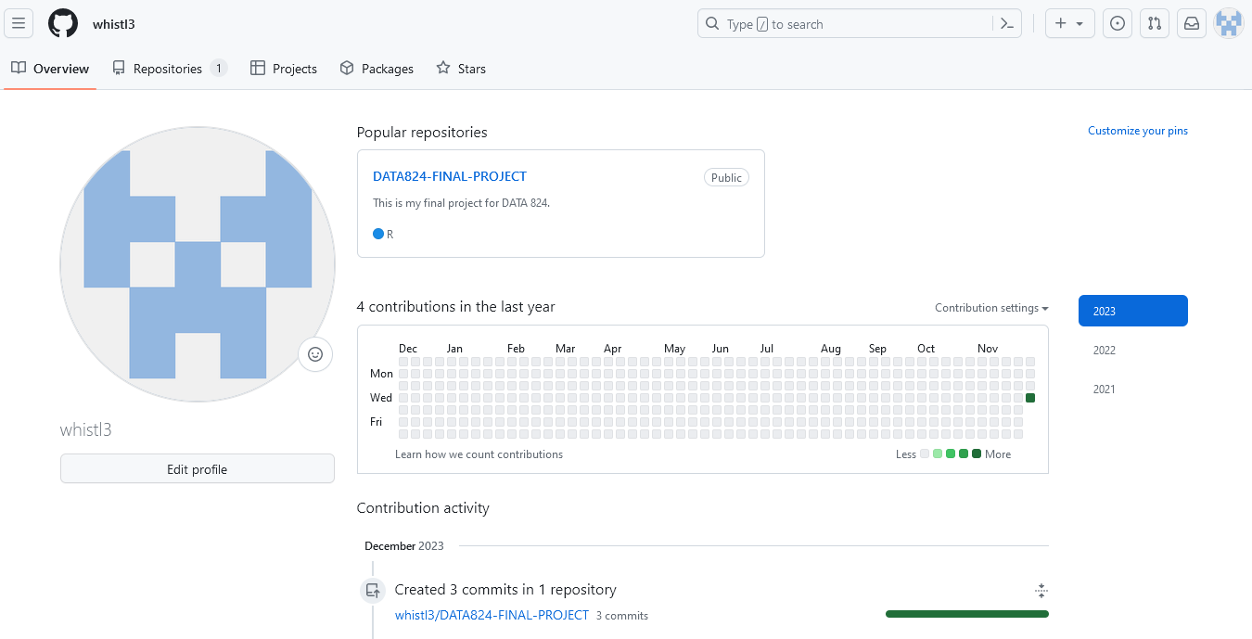
GITHUB INFORMATION
The readme, .csv, app data, and a copy of this PowerPoint can be found at my GitHub page:
https://github.com/whistl3

Slide 10
THANK YOU For a GREAT SEMESTER!

